Slide 1
The Crystal Mines
4th year project

Slide 2
Introduction
The Crystal Mines is a 2D Metroidvania game which has a beautiful environment and multiple powerups the player can use to explore & fight off enemies.

Slide 3
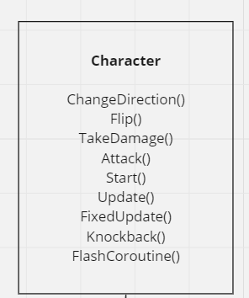
Research
Inheritance

Slide 4
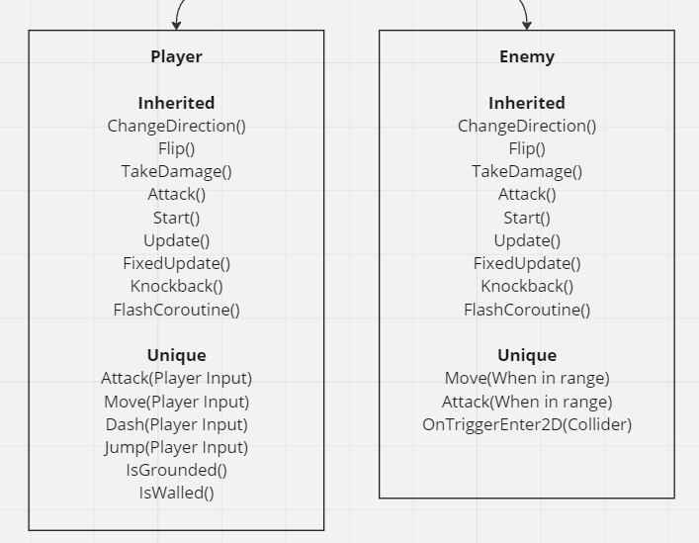
Research
Inheritance

Slide 5
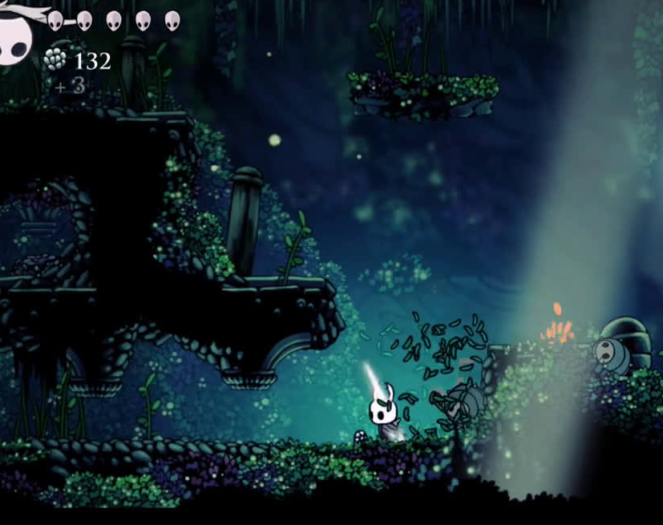
Research
Design

Slide 6
Research
Similar Games
Hollow Knight
Ori and the Will of the Wisps
Celeste

Slide 7
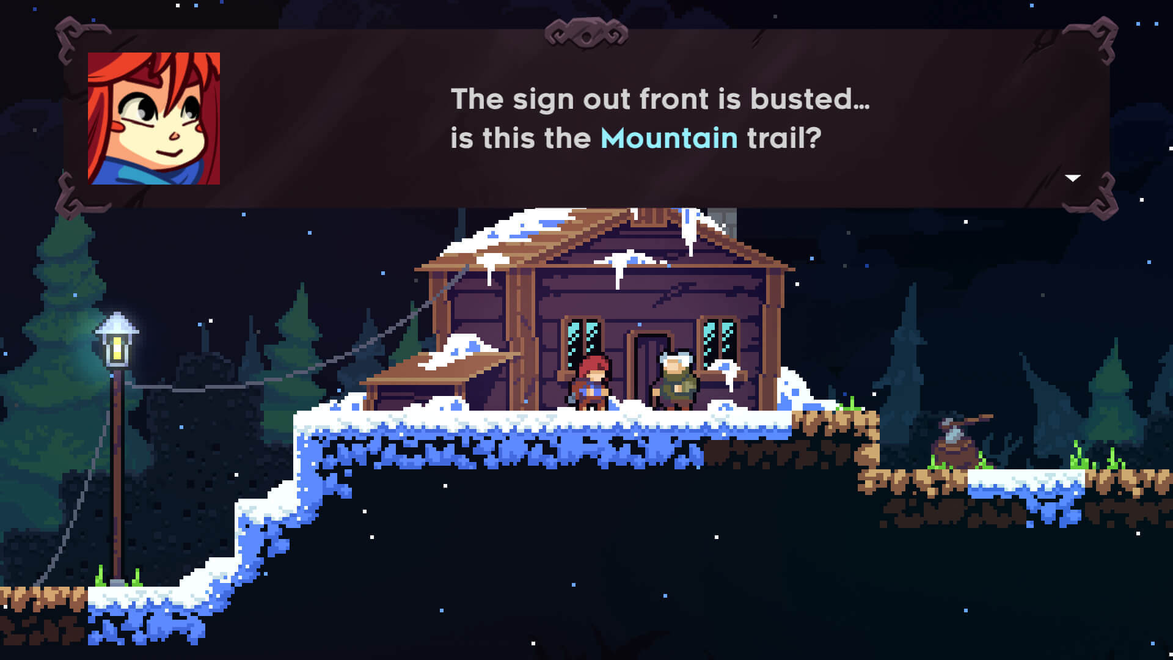
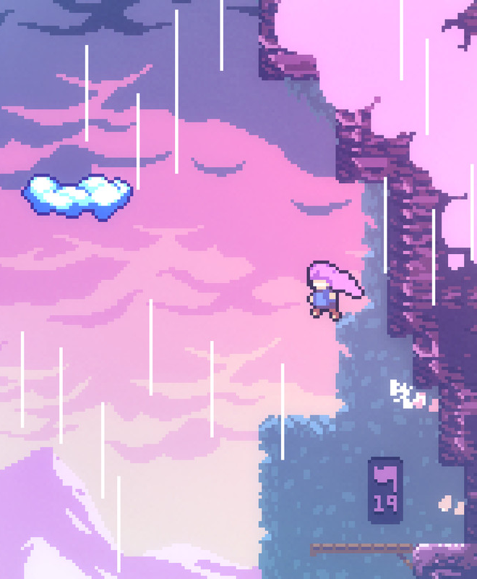
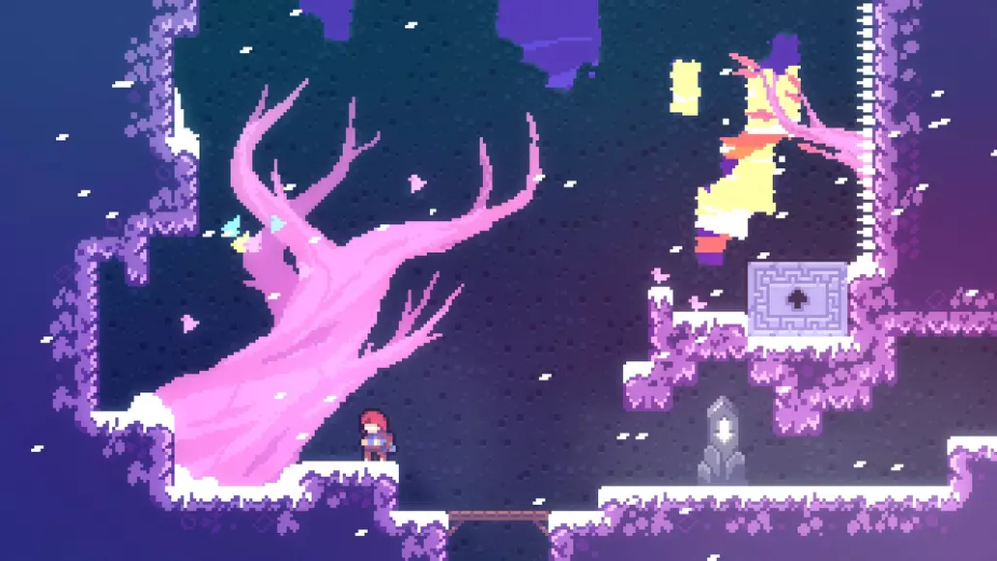
Celeste
Platformer
Jumping puzzles
Story focused

Slide 8
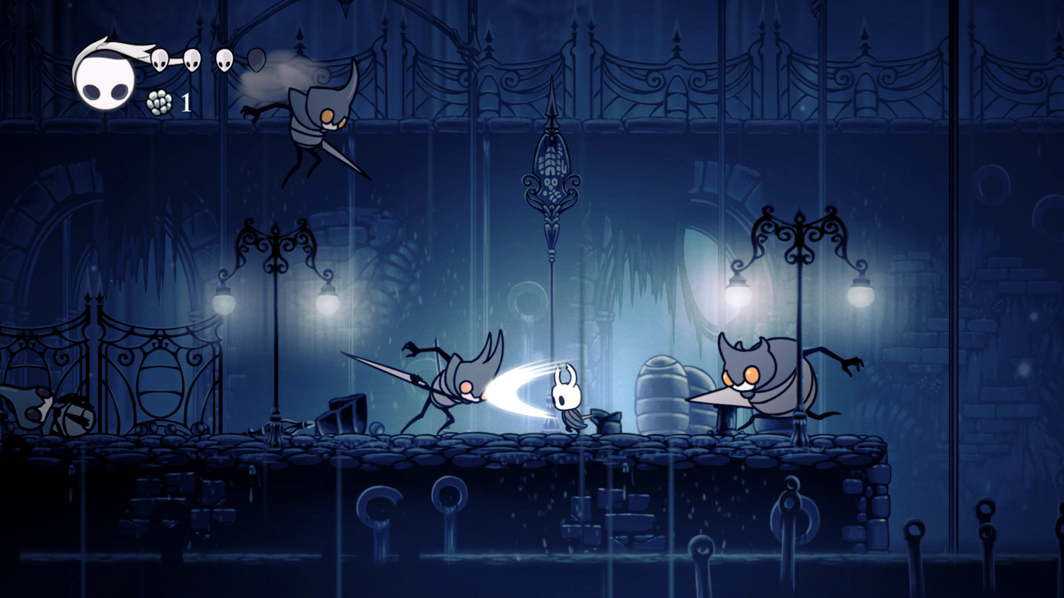
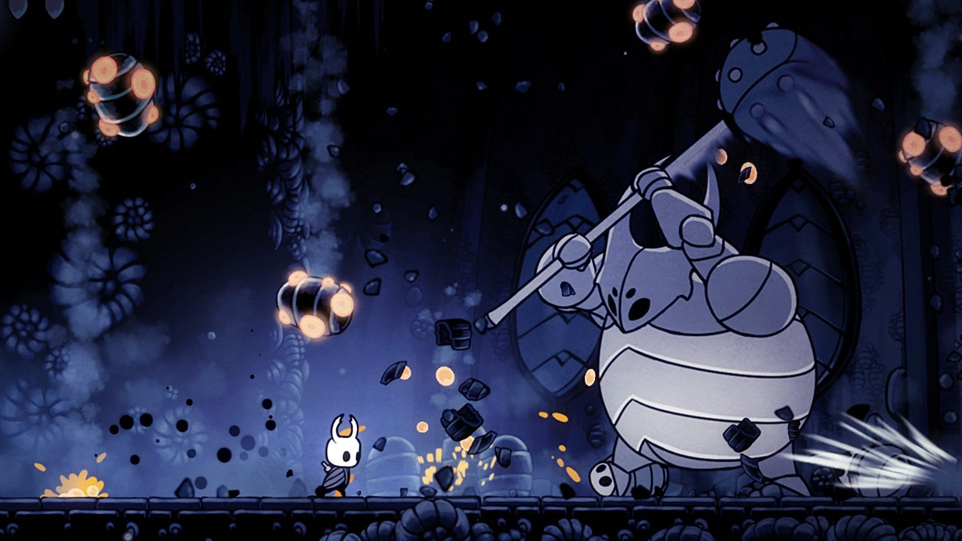
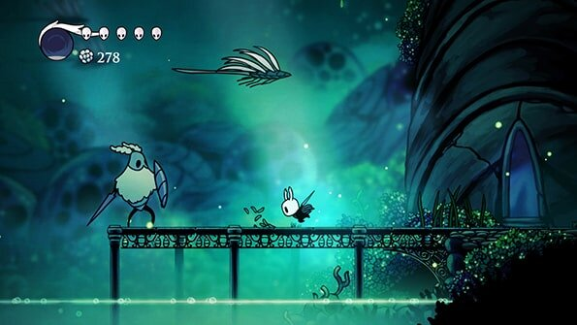
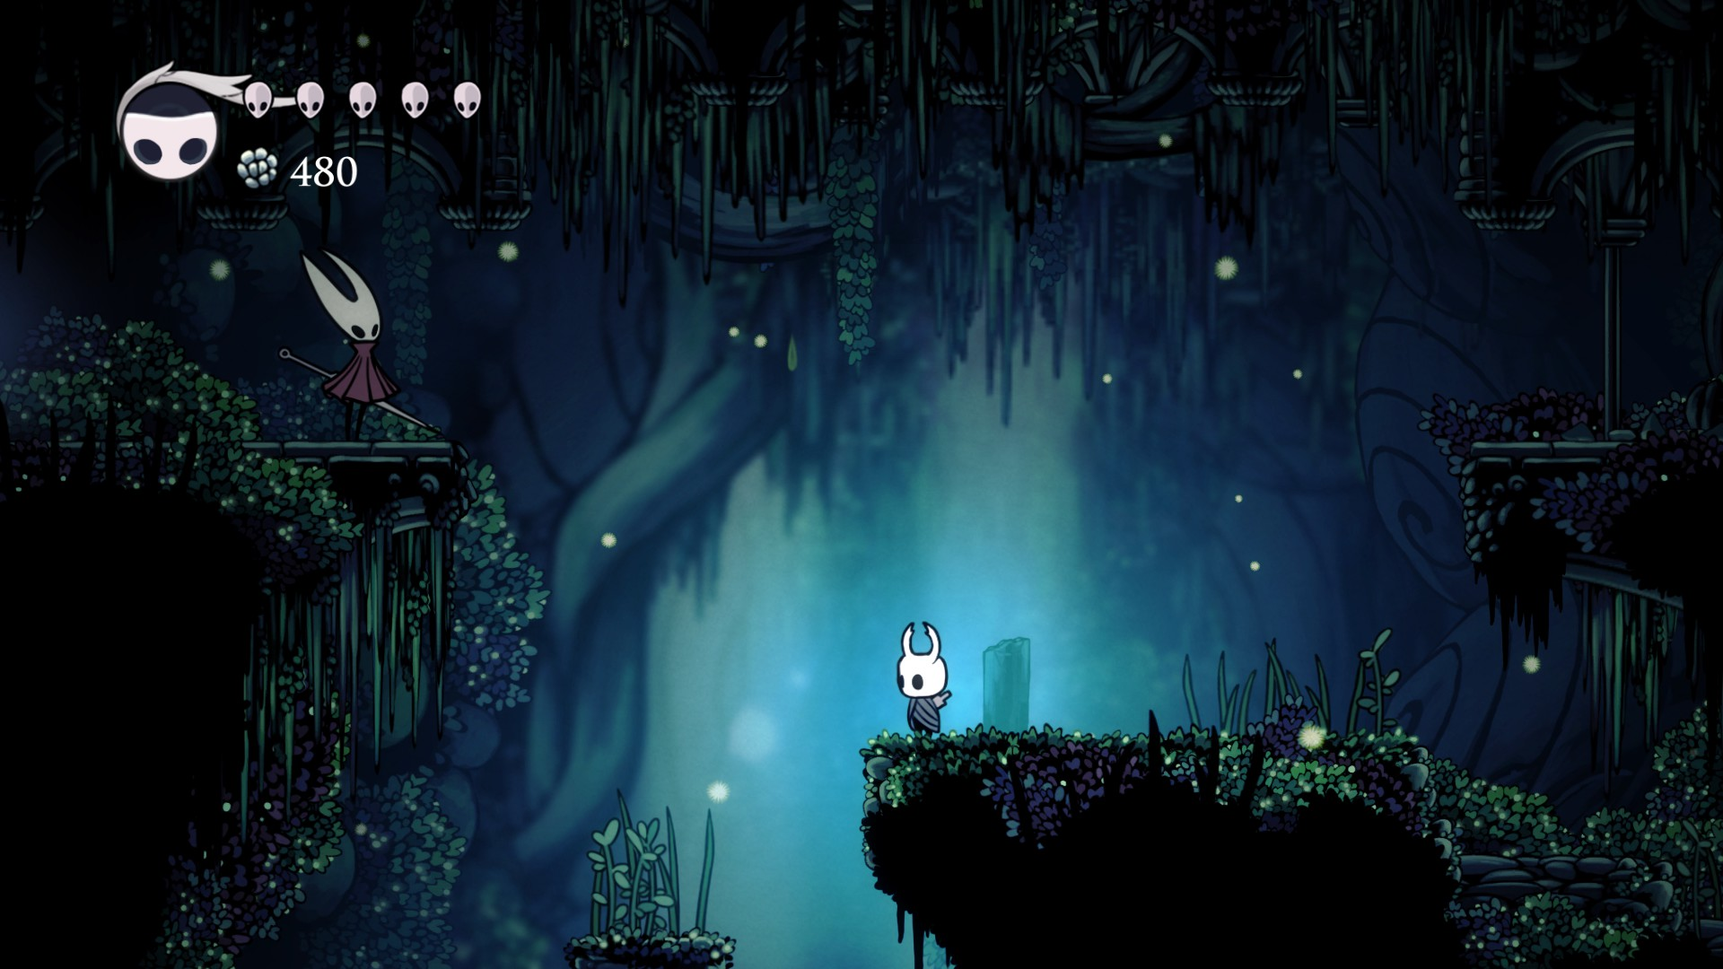
Hollow Knight
Many Optional Boss Fights
Many different types of enemies.
Beautiful environment
Lighting
Fun but challenging combat

Slide 9
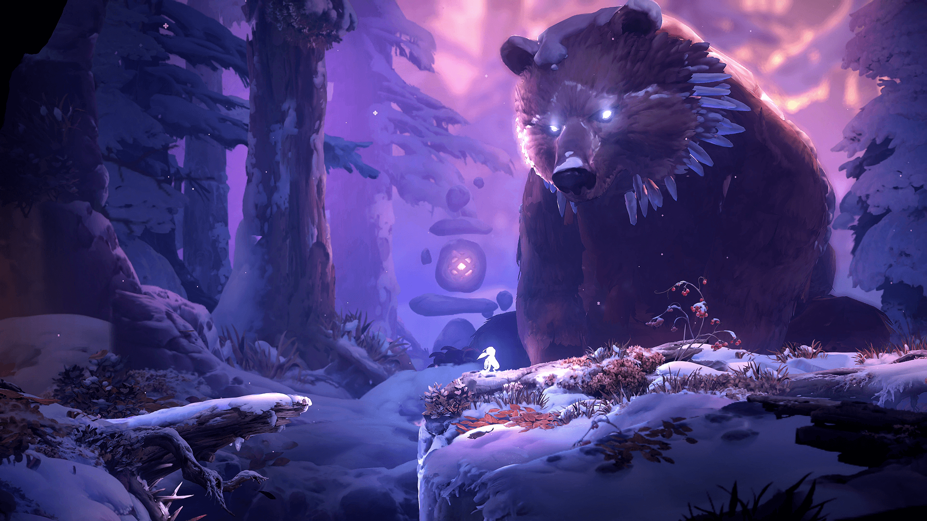
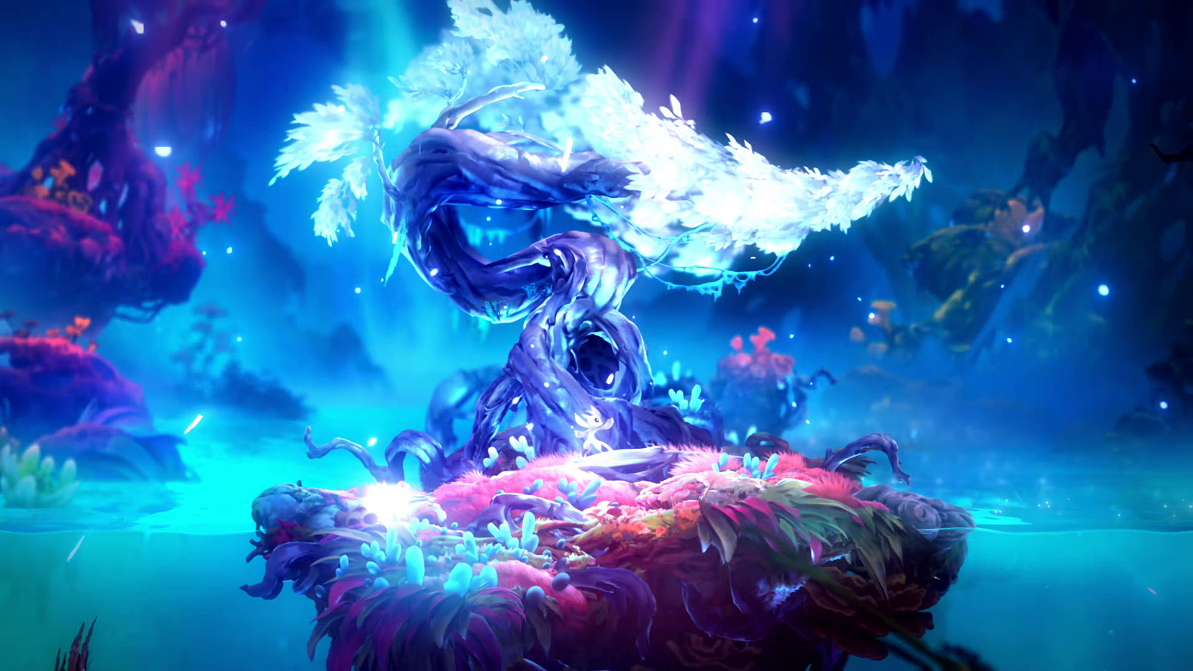
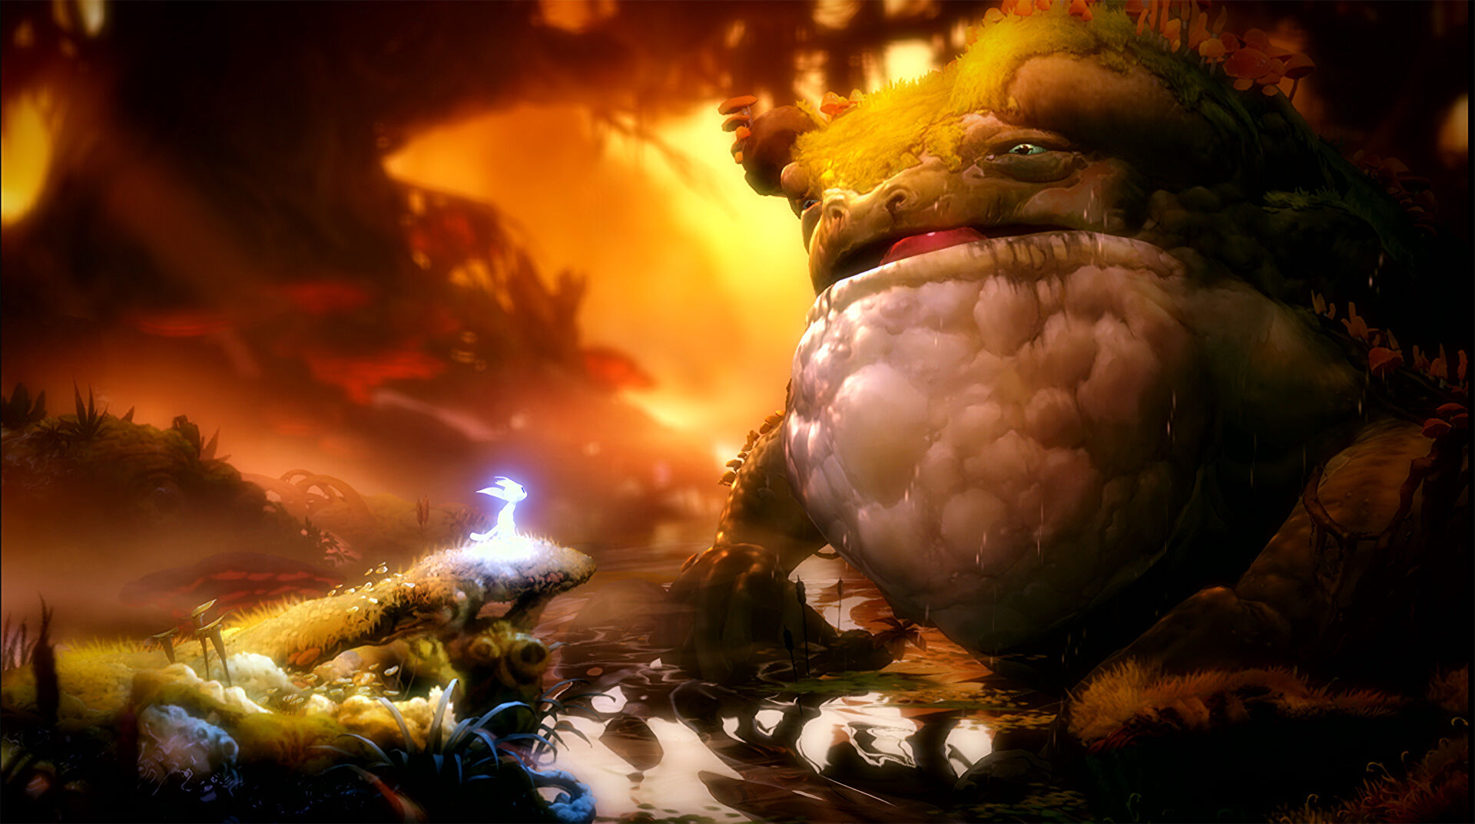

Ori and the Will of the Wisps
Unique combat (each hit carries a lot of weight)
Unique ability upgrades e.g., slingshot for movement, and multiple attack moves

Slide 10
Technologies
Unity Engine Version 2020.3.20f1
Visual studio code
Trello & Journaling

Slide 11
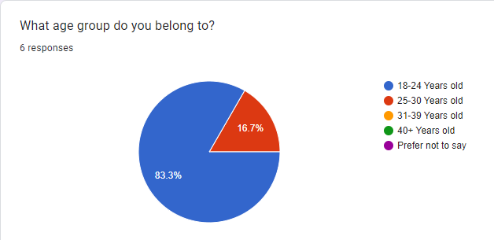
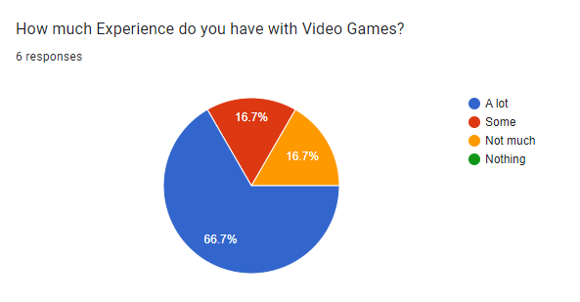
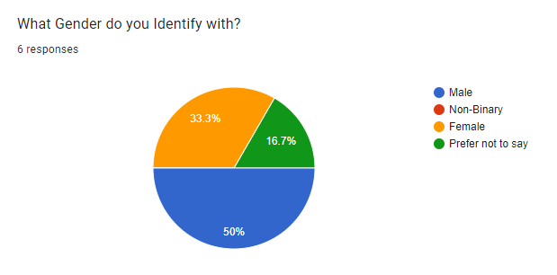
Functionality / Requirements

Slide 12
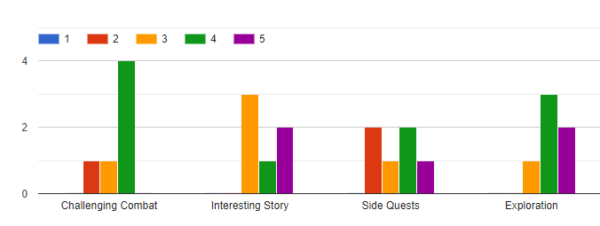
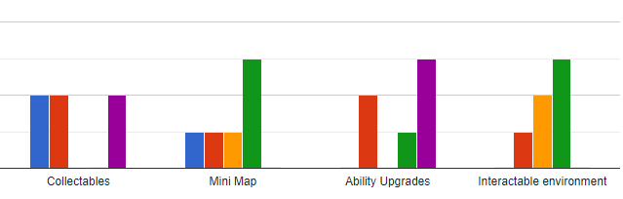
Survey

Slide 13
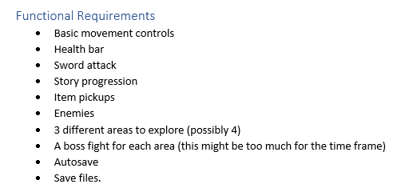
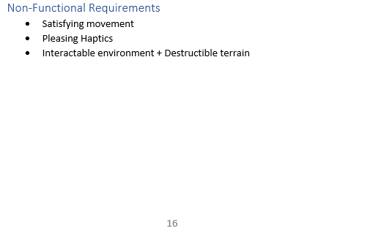
Implemented Requirements
Satisfying movement controls
Health bar
Sword Attack
Story progression
Enemies
2 Different Areas to Explore
Pleasing Haptics (can be improved)

Slide 14
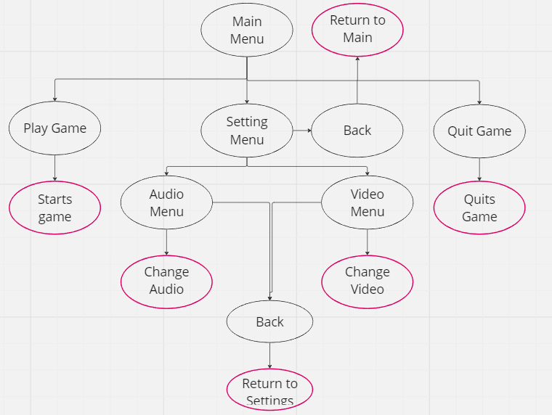
Design

Slide 15
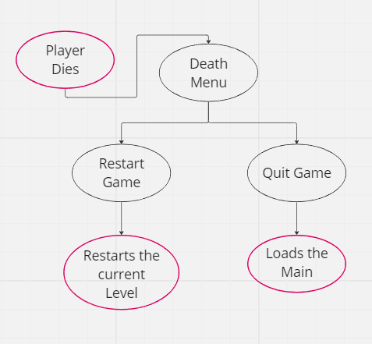
Design

Slide 16
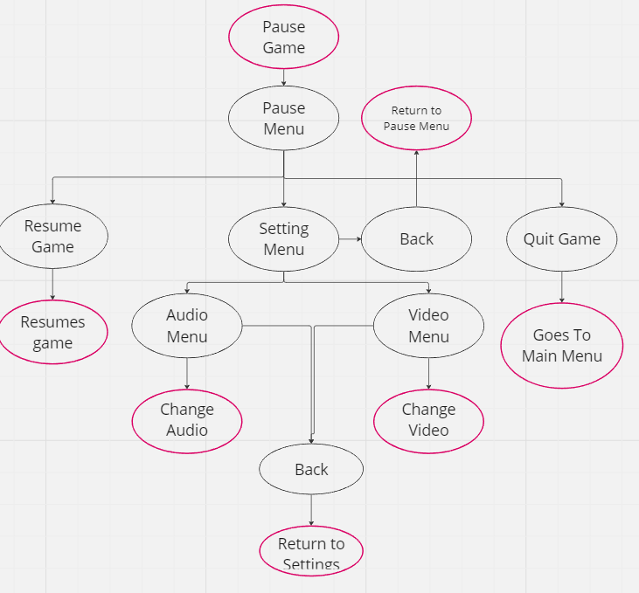
Design

Slide 17
Feature Testing
Bugs
Interact
If the interact button is pressed quickly the typing will type over itself and jumble the words.
Main Menu – Video Menu Resolution Dropdown
This will change it to the lowest resolution. The pause menu resolution dropdown works normally.
Player Dash
Can Dash through some walls if the player jumps as the dash is in progress.

Slide 18
Usability Testing
4 participants with varying degrees of experience tested the game
Feedback
Add knockback to attacks
Add more range to the attack
Movement is good
Explain how to interact with NPCs
Explain how to attack
Explain how to dash

